Slide 1
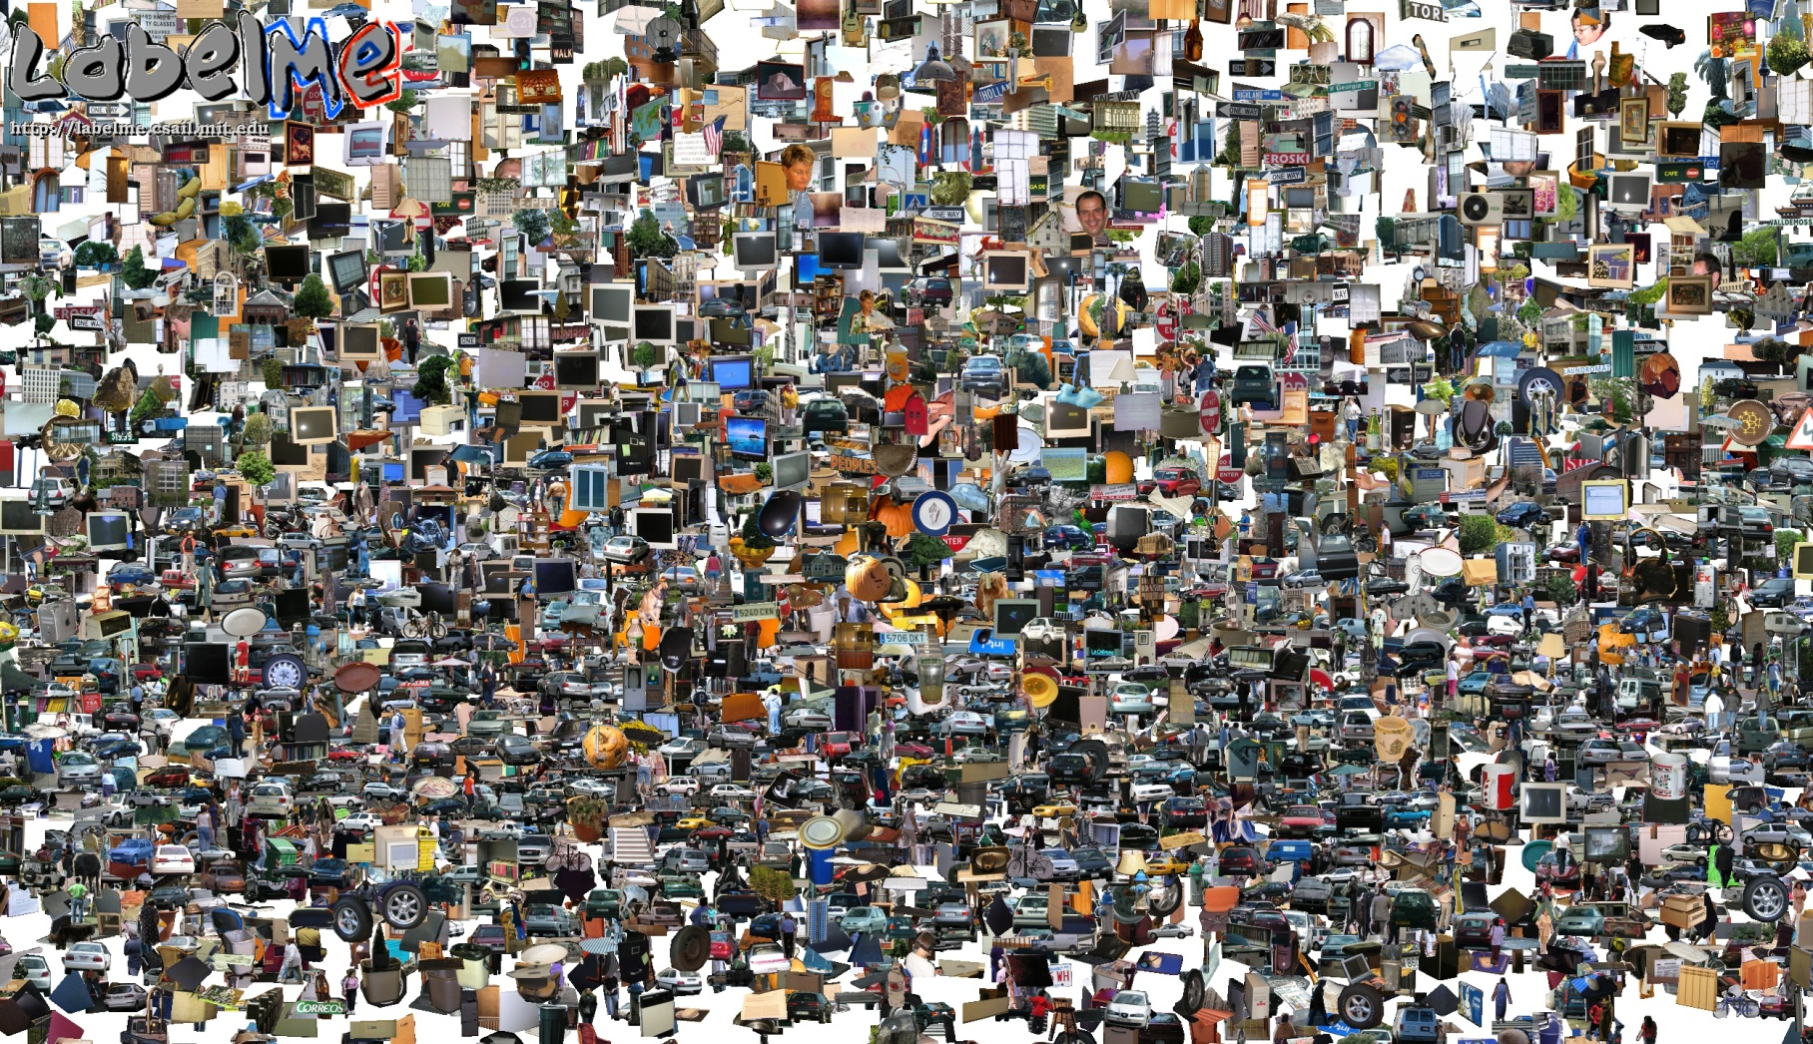
Opportunities of Scale
04/28/11
Computer Vision
Derek Hoiem, University of Illinois
Many slides from Alyosha Efros
Graphic from Antonio Torralba

Slide 2
Today’s class
Opportunities of Scale: Data-driven methods
Scene completion
Im2gps
Recognition via Tiny Images
More recognition by association

Slide 3
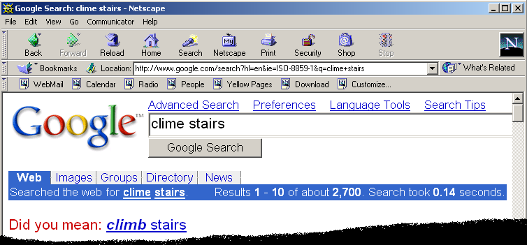
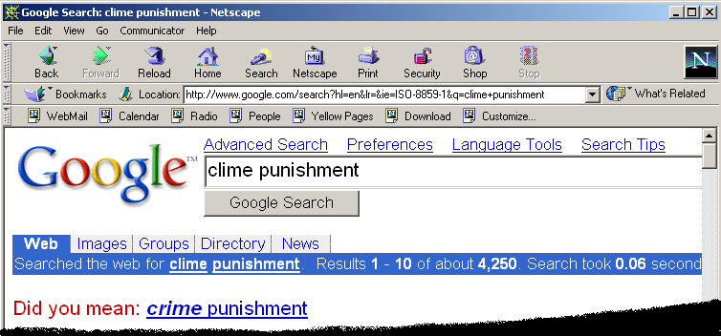
Google and massive data-driven algorithms
A.I. for the postmodern world:
all questions have already been answered…many times, in many ways
Google is dumb, the “intelligence” is in the data

Slide 4

Google Translate

Slide 5
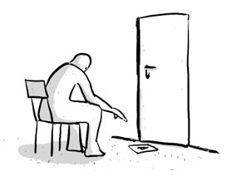
Chinese Room
John Searle (1980)

Slide 6
Image Completion Example
[Hays and Efros. Scene Completion Using Millions of Photographs. SIGGRAPH 2007 and CACM October 2008.]
http://graphics.cs.cmu.edu/projects/scene-completion/

Slide 7
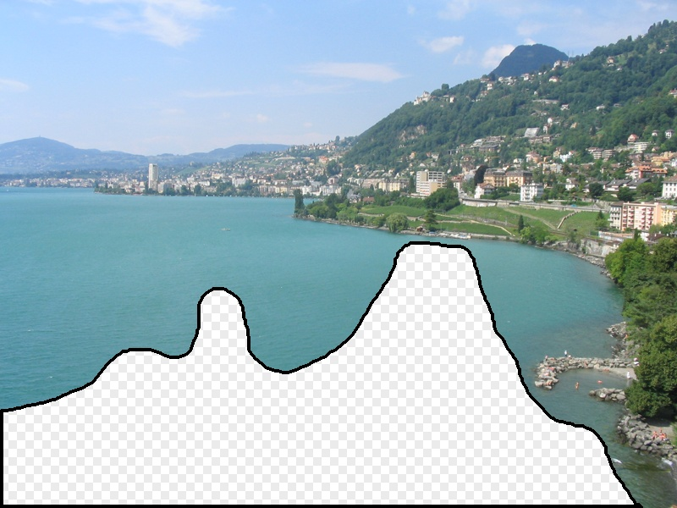
What should the missing region contain?
Notes:
7
What should go here and why?

Slide 8
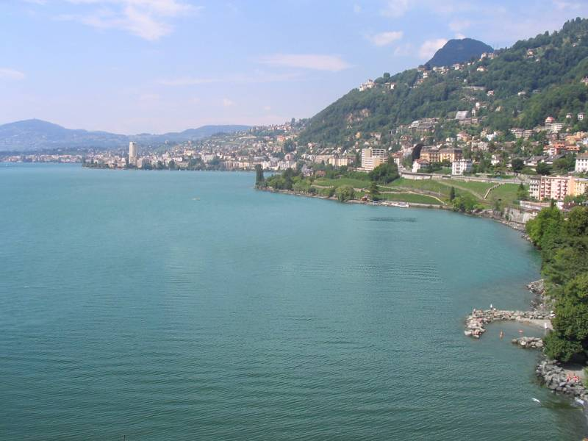

Slide 9
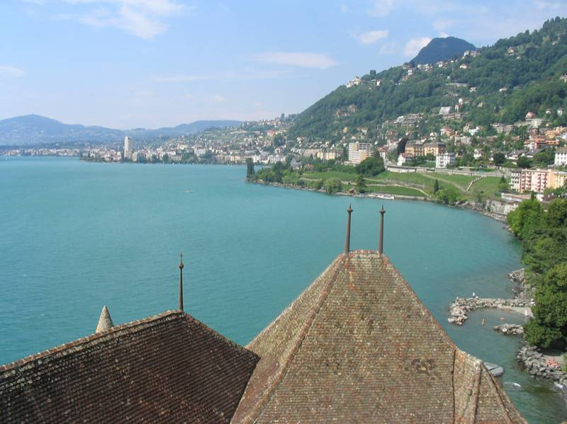
Notes:
9
Introduce gist.

Slide 10
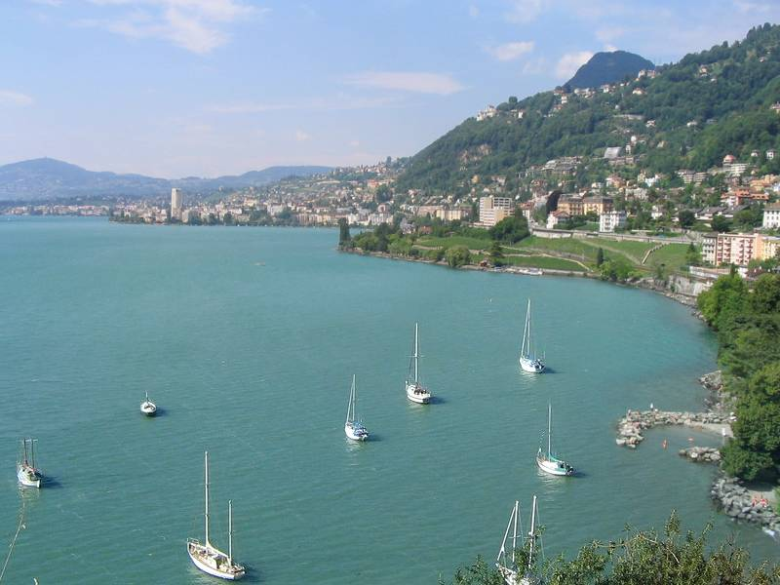

Slide 11
Which is the original?
(a)
(c)
(b)

Slide 12
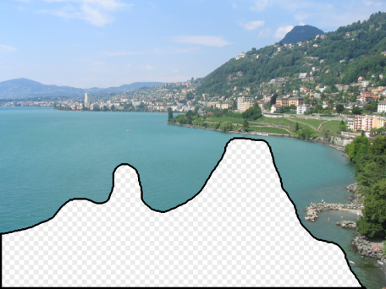

How it works
Find a similar image from a large dataset
Blend a region from that image into the hole
Dataset

Slide 13
General Principal
Huge Dataset
Images
image
matching
Info from Most Similar Images
Input Image
Associated Info
Trick: If you have enough images, the dataset will contain very similar images that you can find with simple maching methods.

Slide 14
How many images is enough?

Slide 15
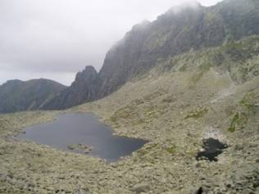
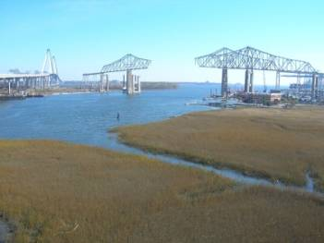
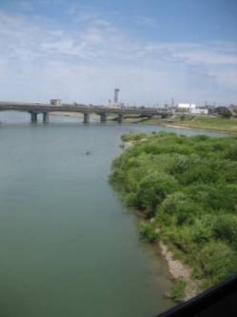

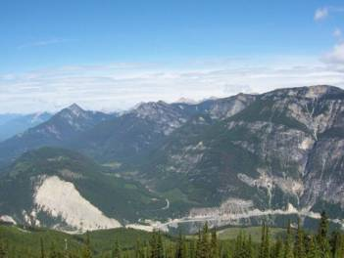
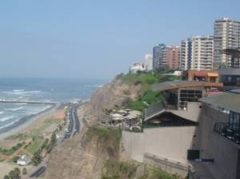
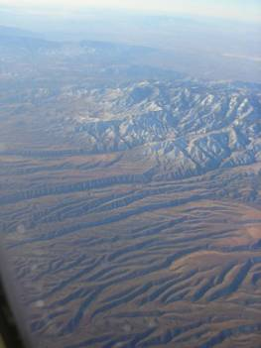
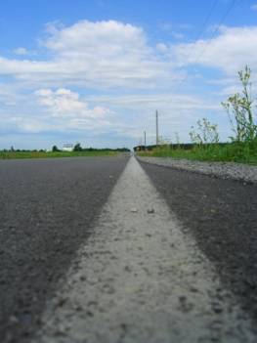
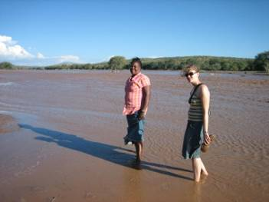
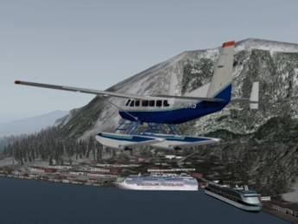
Nearest neighbors from a collection of 20 thousand images
Notes:
15

Slide 16
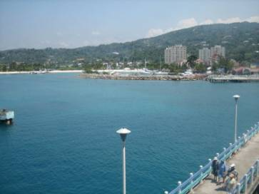
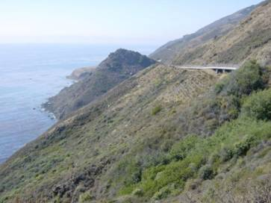
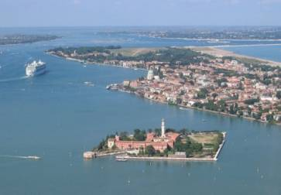
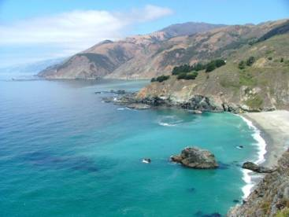

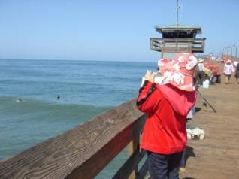
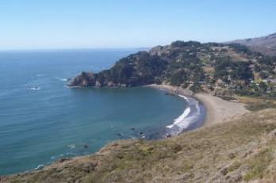
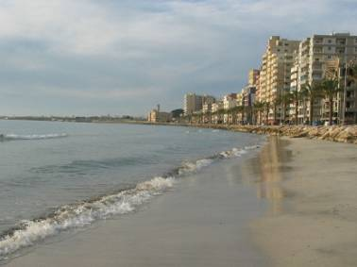
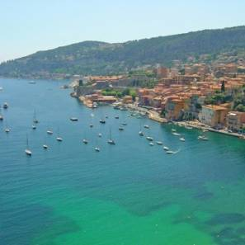
Nearest neighbors from a collection of 2 million images
Notes:
16

Slide 17
Image Data on the Internet
Flickr (as of Sept. 19th, 2010)
5 billion photographs
100+ million geotagged images
Imageshack (as of 2009)
20 billion
Facebook (as of 2009)
15 billion
http://royal.pingdom.com/2010/01/22/internet-2009-in-numbers/

Slide 18
Image completion: how it works
[Hays and Efros. Scene Completion Using Millions of Photographs. SIGGRAPH 2007 and CACM October 2008.]

Slide 19
The Algorithm
Notes:
19
Introduce gist.

Slide 20
Scene Matching
Notes:
20
Introduce gist.

Slide 21
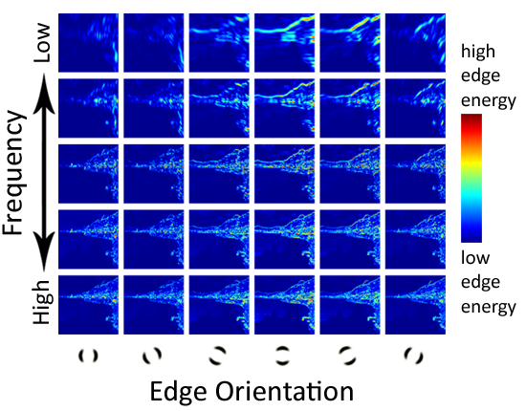
Scene Descriptor
Notes:
Edge energy is just the magnitude of directional derivatives of image intensity.
21

Slide 22
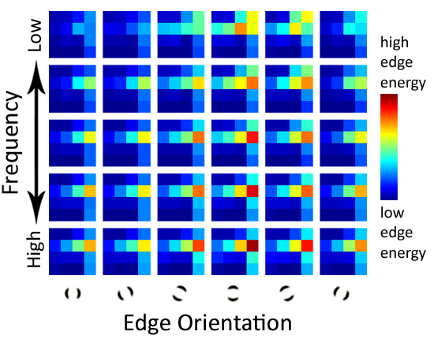
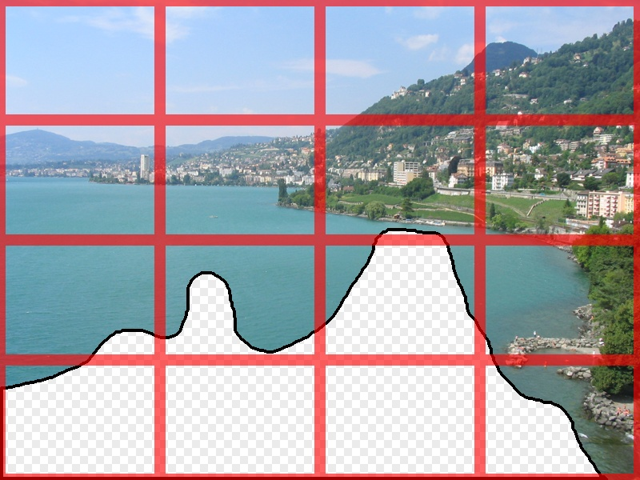
Scene Descriptor
Scene Gist Descriptor (Oliva and Torralba 2001)

Slide 23

Scene Descriptor
+
Scene Gist Descriptor (Oliva and Torralba 2001)

Slide 24

2 Million Flickr Images
Notes:
24
Now we take our gist (and mask and color image) and find it’s L2 nearest neighbors in the database of 2.3 million images, and here they are

Slide 25
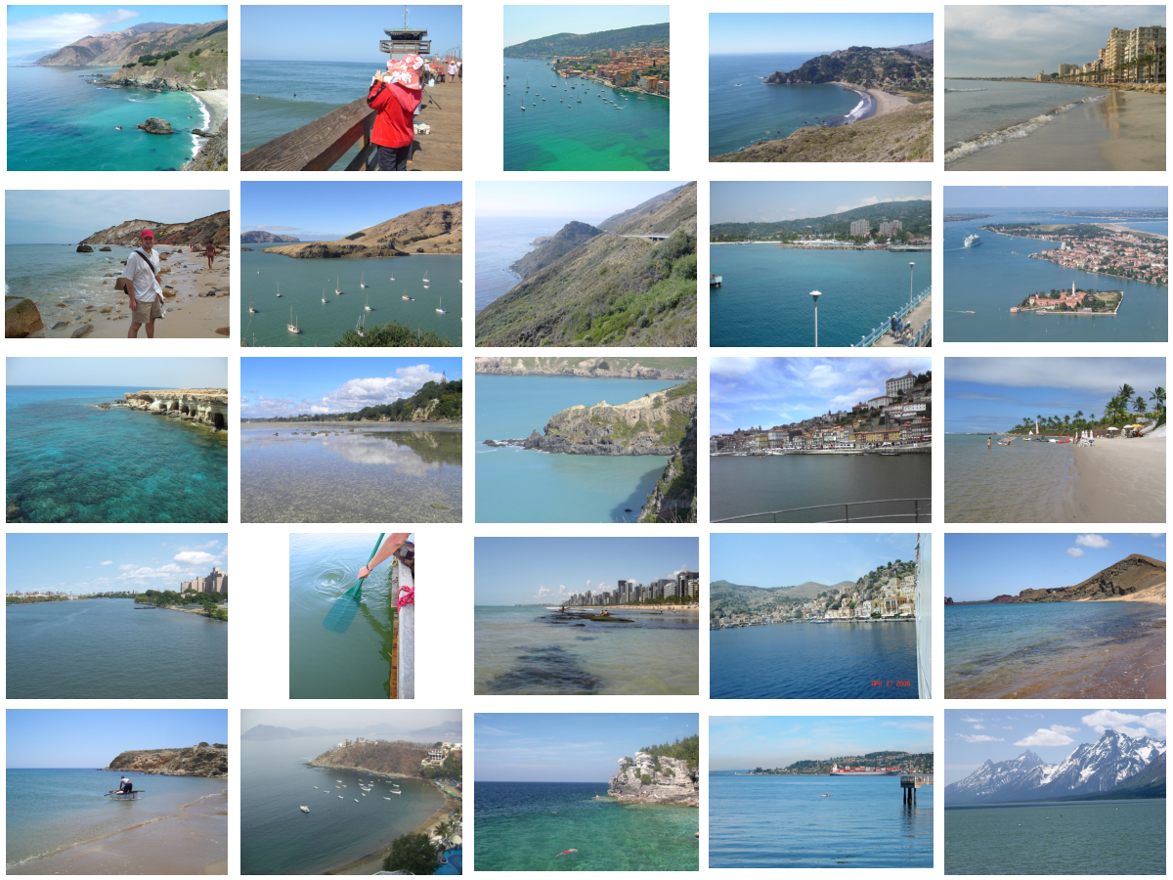
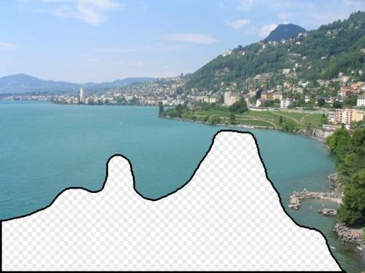
… 200 total
Notes:
25

Slide 26


Context Matching

Slide 27
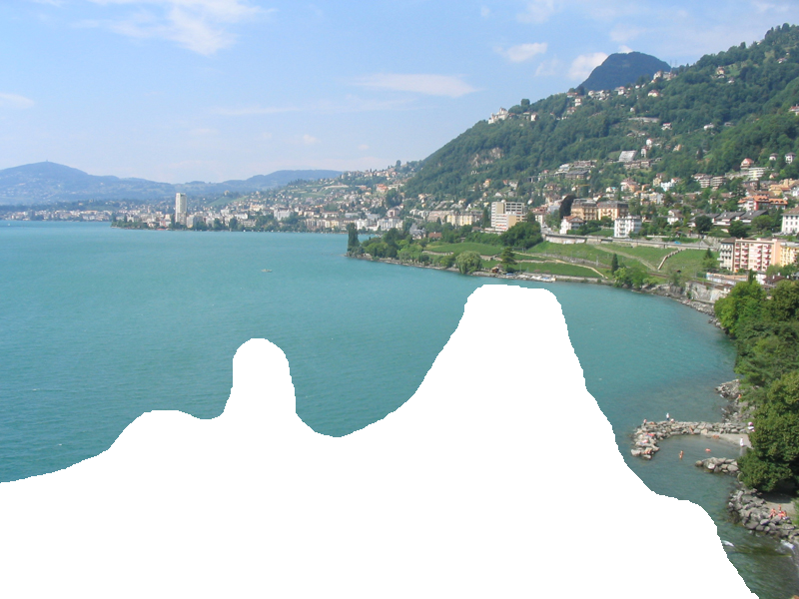

Graph cut + Poisson blending

Slide 28




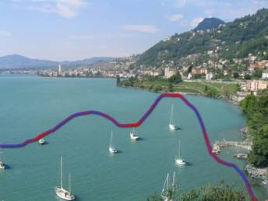
Result Ranking
We assign each of the 200 results a score which is the sum of:
The scene matching distance
The context matching distance (color + texture)
The graph cut cost
Notes:
28
Johnson et al. used the graph cut cost to sort results for users in Semantic Photo Synthesis

Slide 30
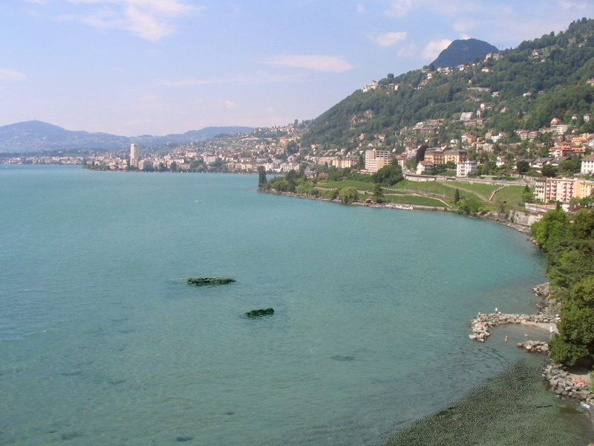

Slide 31
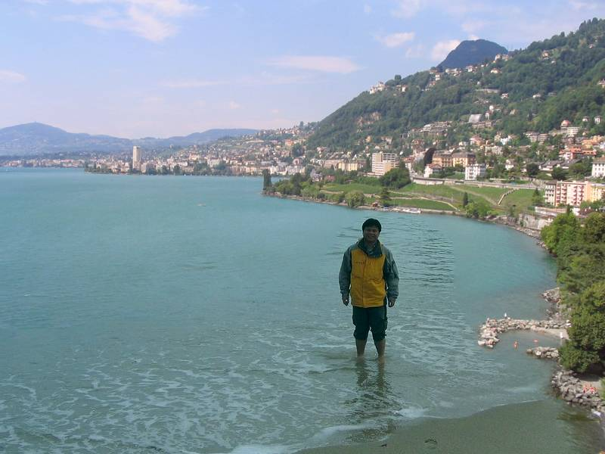

Slide 33
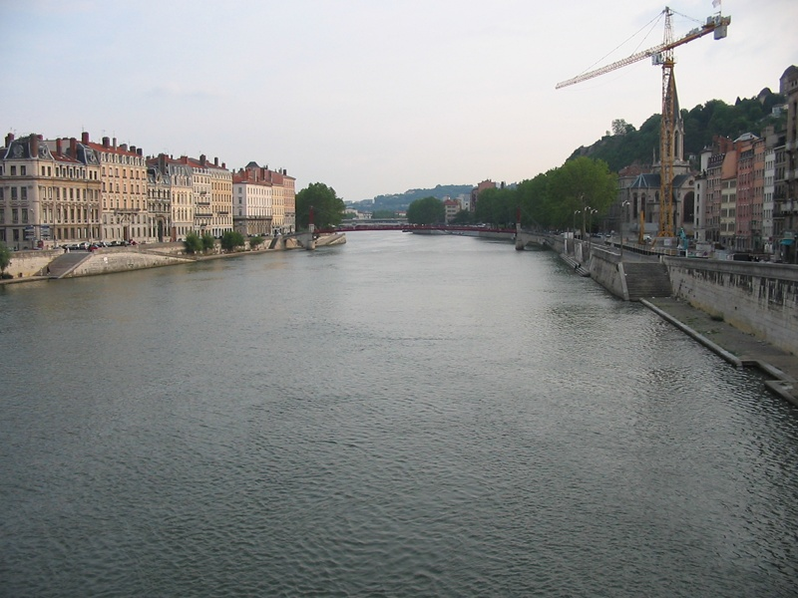
Notes:
33

Slide 34
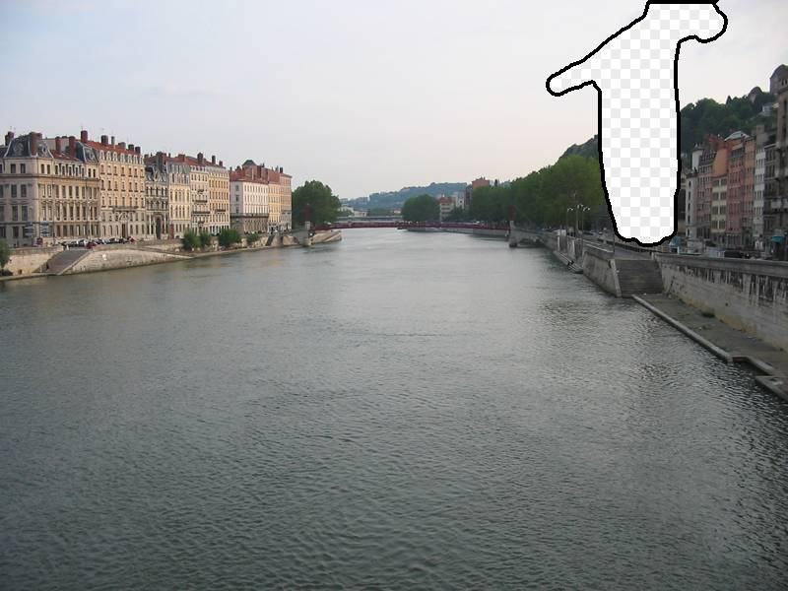
Notes:
34

Slide 35
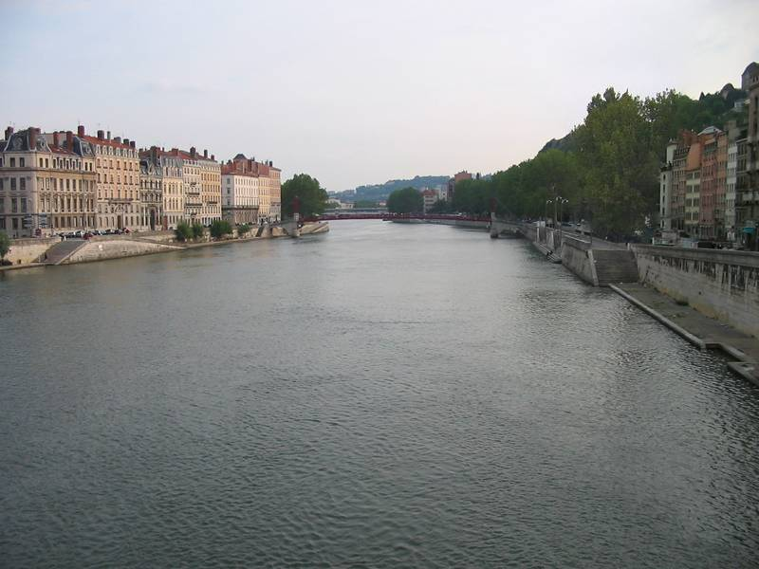
Notes:
35

Slide 36
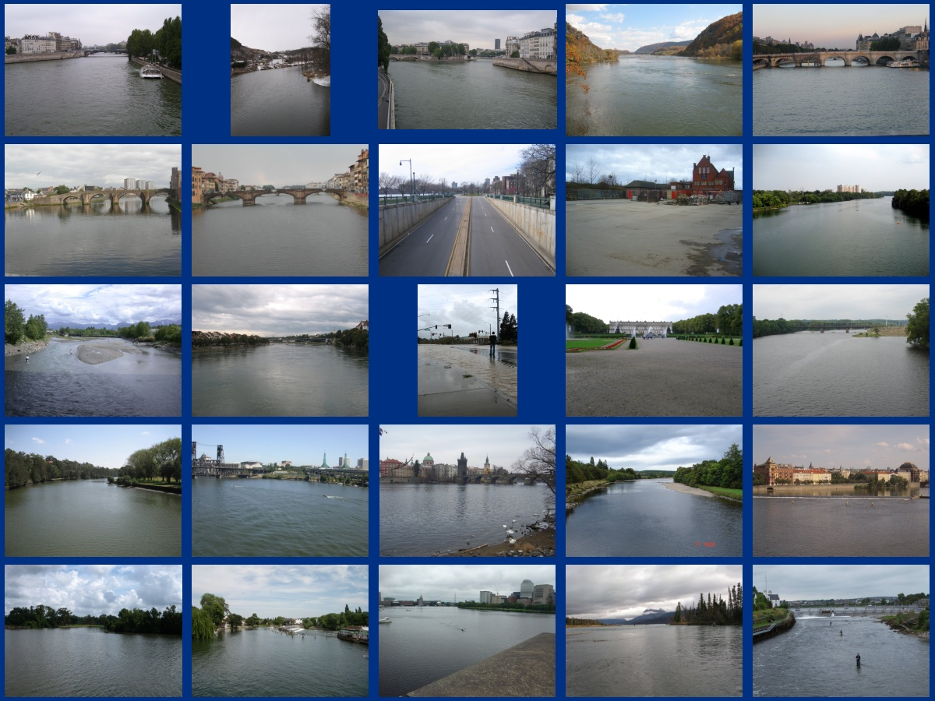
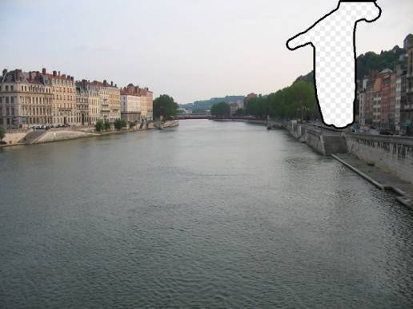
… 200 scene matches
Notes:
36

Slide 37
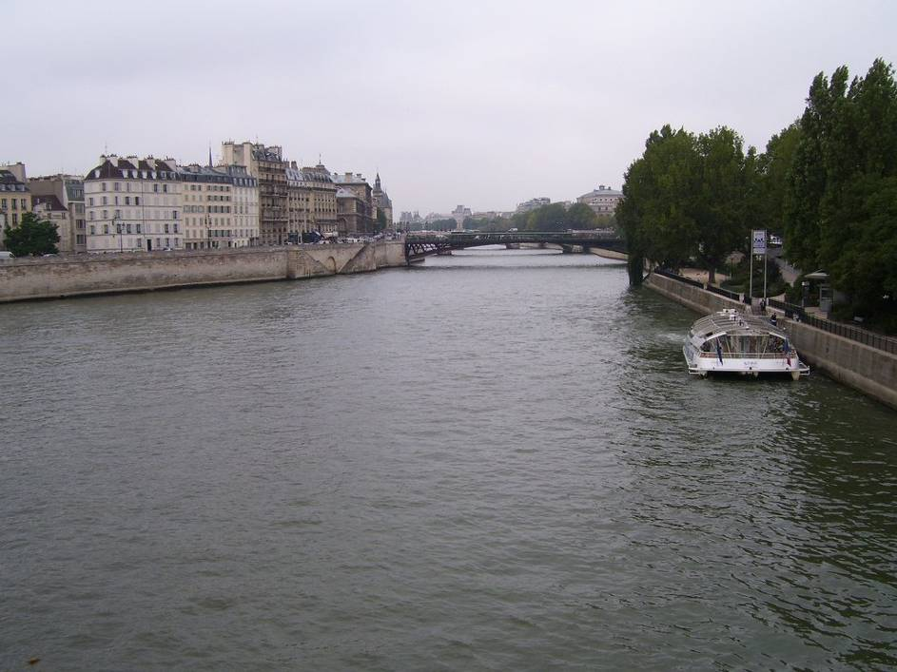
Notes:
37
Not actually the same scene, even though they’re startlingly similar

Slide 39
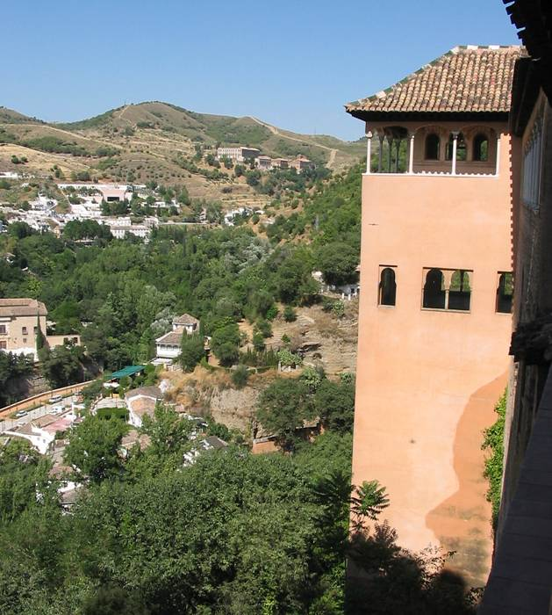

Slide 40
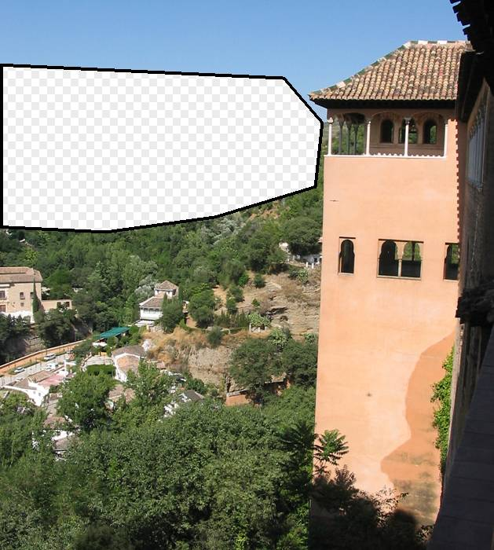

Slide 41
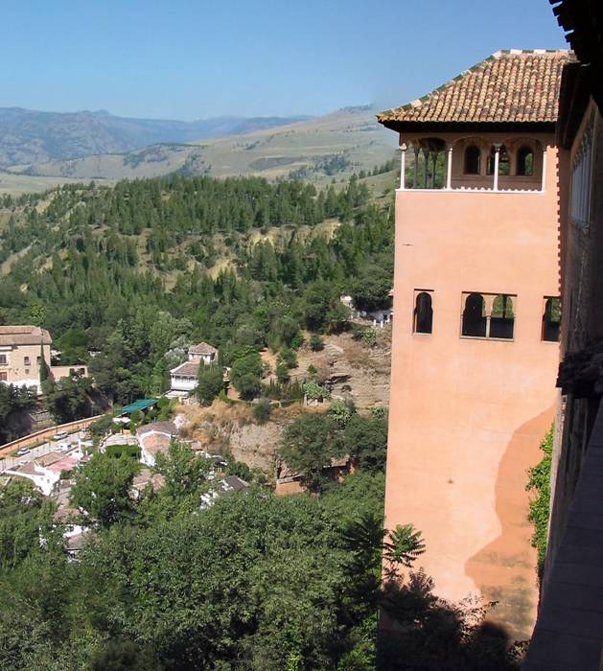

Slide 42
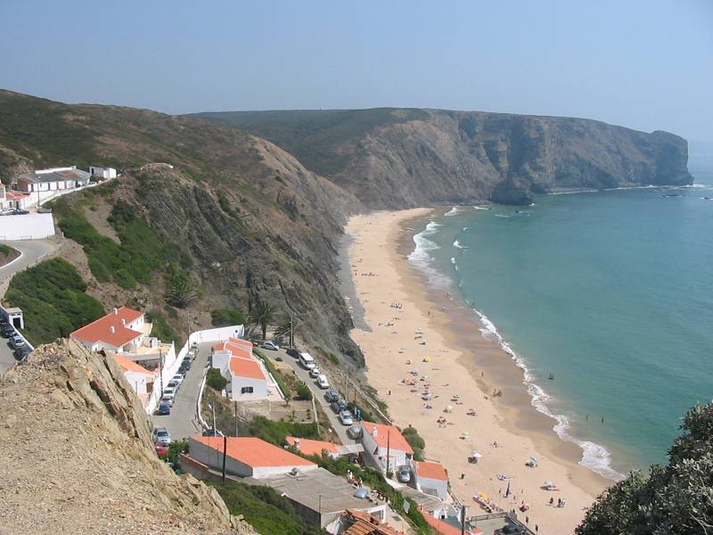
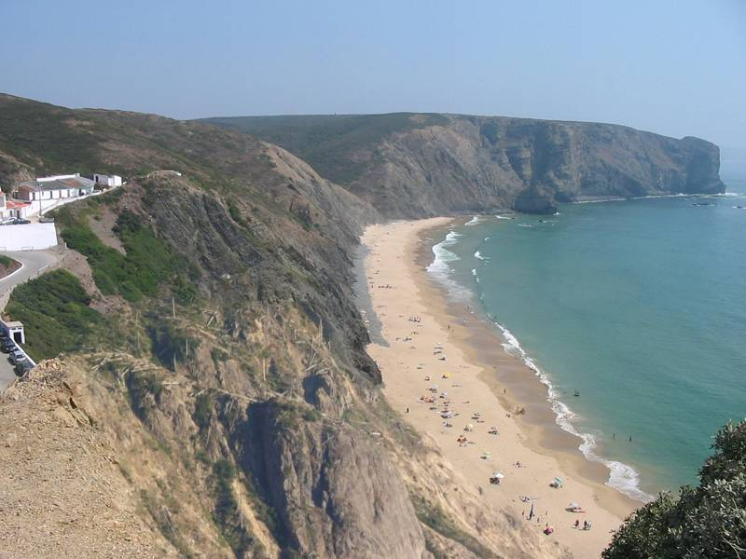
Which is the original?

Slide 43
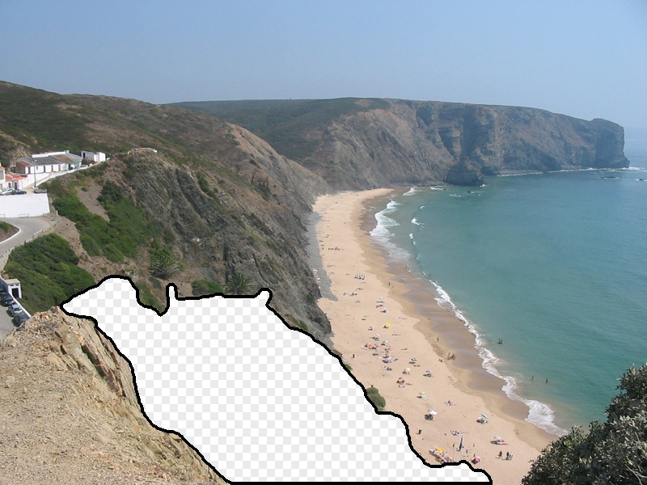

Slide 44
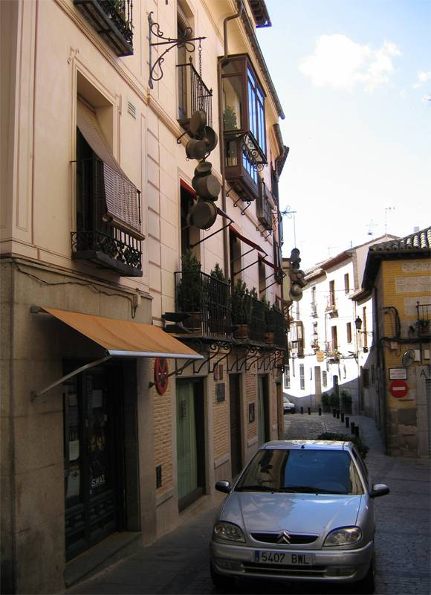
Notes:
44

Slide 45
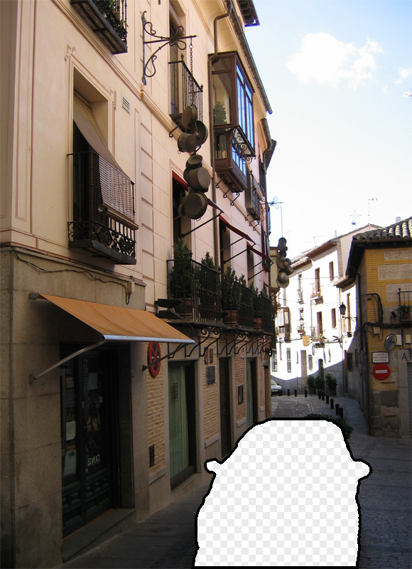
Notes:
45
Can justify broader use of image completion here

Slide 46
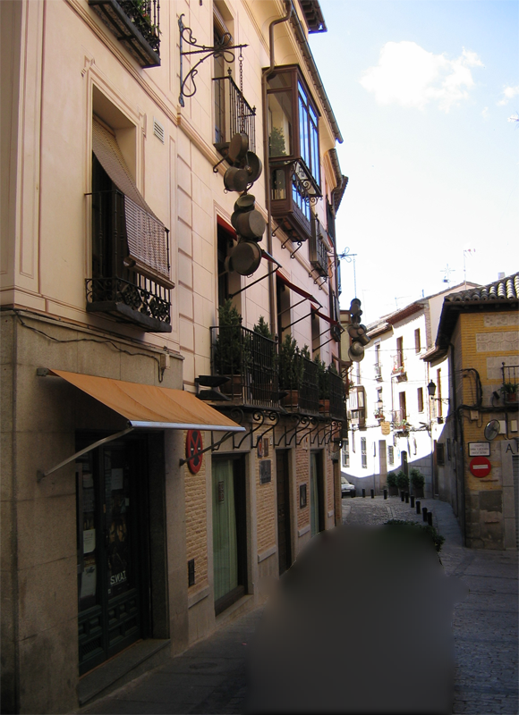
Diffusion Result
Notes:
46

Slide 47

Efros and Leung result
Notes:
47
Efros and leung result

Slide 48

Scene Completion Result

Slide 49

im2gps (Hays & Efros, CVPR 2008)
6 million geo-tagged Flickr images
http://graphics.cs.cmu.edu/projects/im2gps/

Slide 50

How much can an image tell about its geographic location?

Slide 51


Slide 52


Slide 53

Im2gps

Slide 54

Example Scene Matches

Slide 55

Voting Scheme
Notes:
Probability map for that same image
Explain the green circles and how they relate to evaluation
55

Slide 56

im2gps

Slide 57


Slide 58


Slide 59

Effect of Dataset Size

Slide 60

Population density ranking
High Predicted Density
Low Predicted Density

Slide 61

Where is This?
[Olga Vesselova, Vangelis Kalogerakis, Aaron Hertzmann, James Hays, Alexei A. Efros. Image Sequence Geolocation. ICCV’09]
Notes:
61

Slide 62

Where is This?

Slide 63

Where are These?
15:14, June 18th, 2006
16:31, June 18th, 2006
Notes:
Individually each photograph is 16%, but together they reinforce each other well
63

Slide 64

Where are These?
15:14, June 18th, 2006
16:31, June 18th, 2006
17:24, June 19th, 2006
Notes:
If you know that brits love to vacation in greece…
64

Slide 65

Results
im2gps – 10% (geo-loc within 400 km)
temporal im2gps – 56%

Slide 66

Tiny Images
80 million tiny images: a large dataset for non-parametric object and scene recognition Antonio Torralba, Rob Fergus and William T. Freeman. PAMI 2008.
http://groups.csail.mit.edu/vision/TinyImages/

Slide 67



Slide 68

Human Scene Recognition

Slide 69

Humans vs. Computers: Car-Image Classification
Various computer vision algorithms for full resolution images
Humans for 32 pixel tall images

Slide 70





Powers of 10
Number of images on my hard drive: 10⁴
Number of images seen during my first 10 years: 10⁸
(3 images/second * 60 * 60 * 16 * 365 * 10 = 630720000)
Number of images seen by all humanity: 10²⁰
106,456,367,669 humans¹ * 60 years * 3 images/second * 60 * 60 * 16 * 365 =
1 from http://www.prb.org/Articles/2002/HowManyPeopleHaveEverLivedonEarth.aspx
Number of photons in the universe: 10⁸⁸
Number of all 32x32 images: 10⁷³⁷³
256 ^{32*32*3} ~ 10⁷³⁷³
Notes:
so don’t listen to anyone claiming to brute force image space
But most of image space is empty, never observed

Slide 71



Scenes are unique
Notes:
Scene and object recognition at human performance is very hard because we are able to deal with so many different kinds of scenes…
Scenes are so unique.

Slide 72









But not all scenes are so original
Notes:
But most scenes are not really like that. Most of the time, scenes are boring places in which nothing really surprising happens. For instance, this street… there is nothing really special about it. In fact, I can easily find thousands of other street pictures that look just like this. Of course, these scenes are different in the details, just as two faces are different, but at a coarser level they are form by similar objects arranged in a similar spatial configuration.

Slide 73
Lots
Of
Images
A. Torralba, R. Fergus, W.T.Freeman. PAMI 2008

Slide 74
Lots
Of
Images
A. Torralba, R. Fergus, W.T.Freeman. PAMI 2008

Slide 75
Lots
Of
Images

Slide 76






Application: Automatic Colorization
Input
Color Transfer
Color Transfer
Matches (gray)
Matches (w/ color)
Avg Color of Match

Slide 77






Application: Automatic Colorization
Input
Color Transfer
Color Transfer
Matches (gray)
Matches (w/ color)
Avg Color of Match

Slide 78

Application: Person Detection
80 million “tiny images” downloaded by keyword search.
80 nearest neighbors vote for image category.

Slide 79

Re-ranking Altavista search for “person”

Slide 80

Automatic Orientation Examples
A. Torralba, R. Fergus, W.T.Freeman. 2008
Notes:
Based on average correlation to the top 50 nearest neighbors. Note that this doesn’t really beat just assuming that the image is upright.
80

Slide 81

Recognition by Association
Rather than categorizing objects, associate them to stored examples of objects and transfer the associated labels.
Malisiewicz and Efros (NIPS 2009)

Slide 82

Recognition by Association
Rather than categorizing objects, associate them with stored examples of objects and transfer the associated labels.
Malisiewicz and Efros (CVPR 2008)

Slide 83



Training procedure
Learn a region similarity measure from hand-segmented objects in LabelMe
Similarity features
Shape: region mask, pixel area, bounding box size
Texture: normalized texton histogram
Color: mean RGB, std RGB, color histogram
Position: coarse 8x8 image mask, coords of top/bottom pixels

Slide 84



Training procedure
Learn a distance/similarity measure for each region
Minimize distance to K most similar examples from same category
Maximize distance to examples from other categories
distance weights
distance measures
Set to 1 for K nearest examples
Hinge Loss

Slide 85


Learned Similarity Measure
Learned
Distance
Texton
Distance

Slide 86

Learned Similarity Measure

Slide 87
Testing procedure
Create multiple segmentations (MeanShift + Ncuts)
Find similar object regions in training set; each votes for the object label
What about bad segments?
Most of the time, they don’t match any objects in the training set
Consider only associations with distance < 1

Slide 88



Slide 89

Automatic Parses

Slide 90


Bush’s Memex (1945)
Store recorded knowledge on microfilm

Slide 91
Summary
With billions of images on the web, it’s often possible to find a close nearest neighbor
In such cases, we can shortcut hard problems by “looking up” the answer, stealing the labels from our nearest neighbor
For example, simple (or learned) associations can be used to synthesize background regions, colorize, or recognize objects

Slide 92
Next class
Summary and wrap-up
Short summary of computer vision
Important open problems
Feedback (important!)
Short custom form that goes directly to me
ICES forms that go to department, then to me

